Slide 1
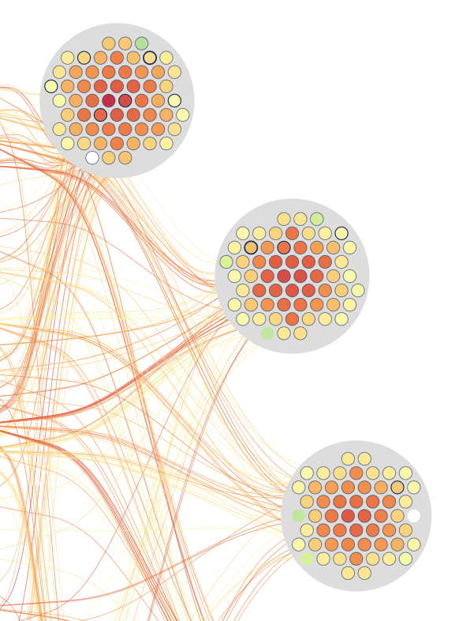
Job monitoring visualization
Weekly report

Slide 2
Content
JobView use case: High CPU2 Temperature
Scagnostics Viewer

Slide 3
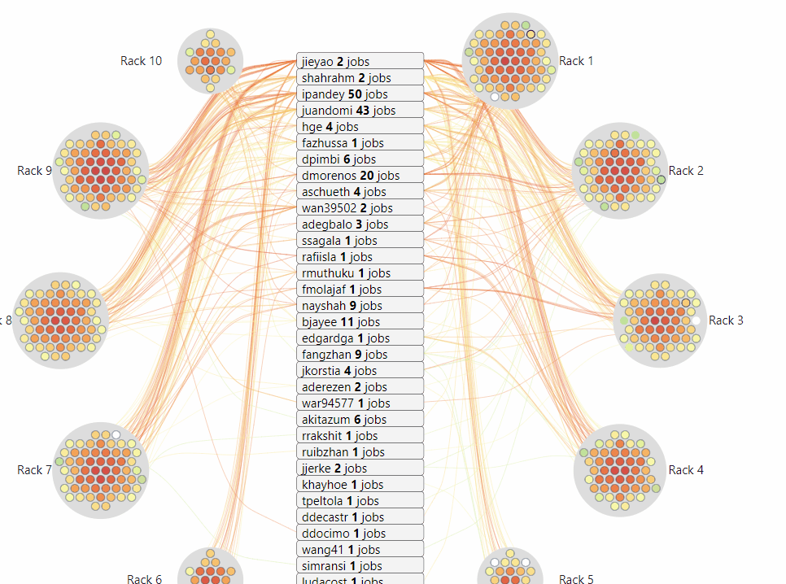
JobViewer
Compute
User
Link
Color by metrics value (e.g: Temperature, Fan speed, etc.)
Border thickness: number of user utilizing the node

Slide 4
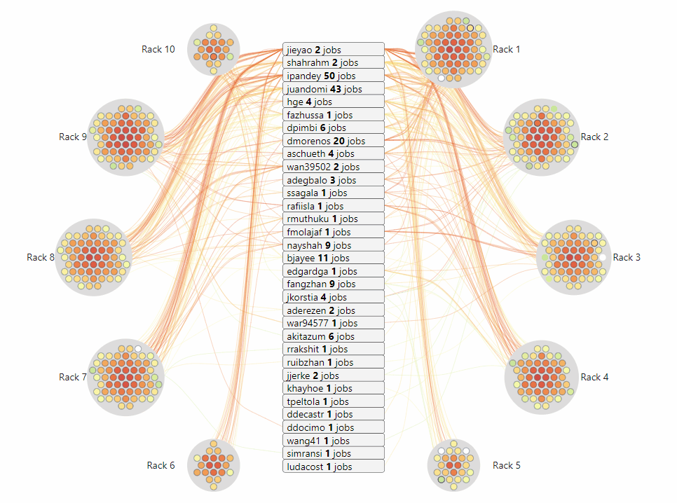
JobViewer
Compute
User
Link
<user_name> <#jobs> jobs
#job: running job the snapshot

Slide 5
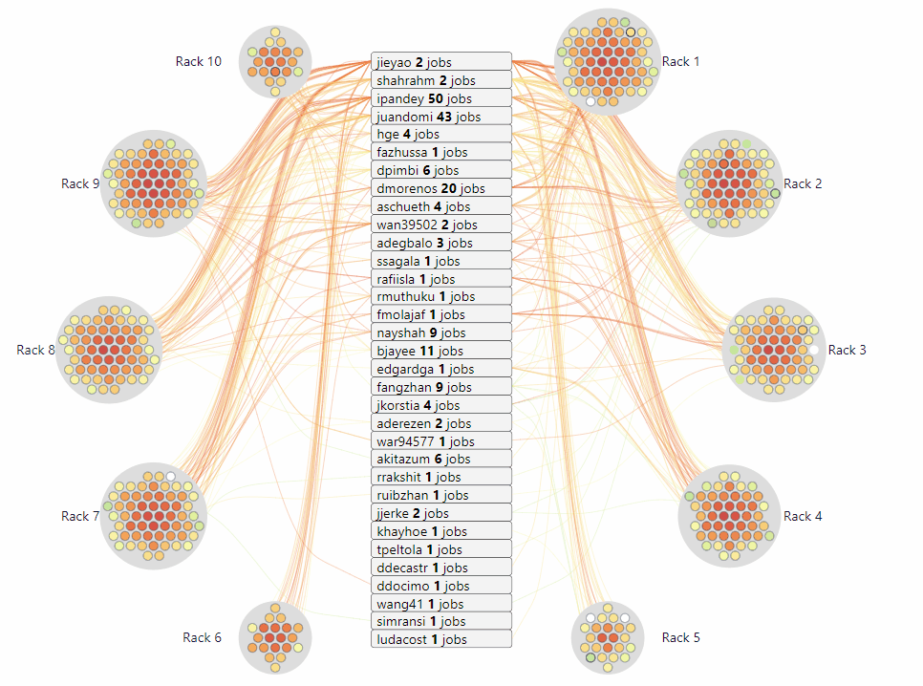
JobViewer
Compute
User
Link
Connect between the user and compute when that user has a running job on that compute

Slide 6
JobViewer
Historical data
https://idatavisualizationlab.github.io/HPCC/jobviewer/index.html
Realtime
https://idatavisualizationlab.github.io/HPCC/jobviewer/index.html?mode=realTime

Slide 7
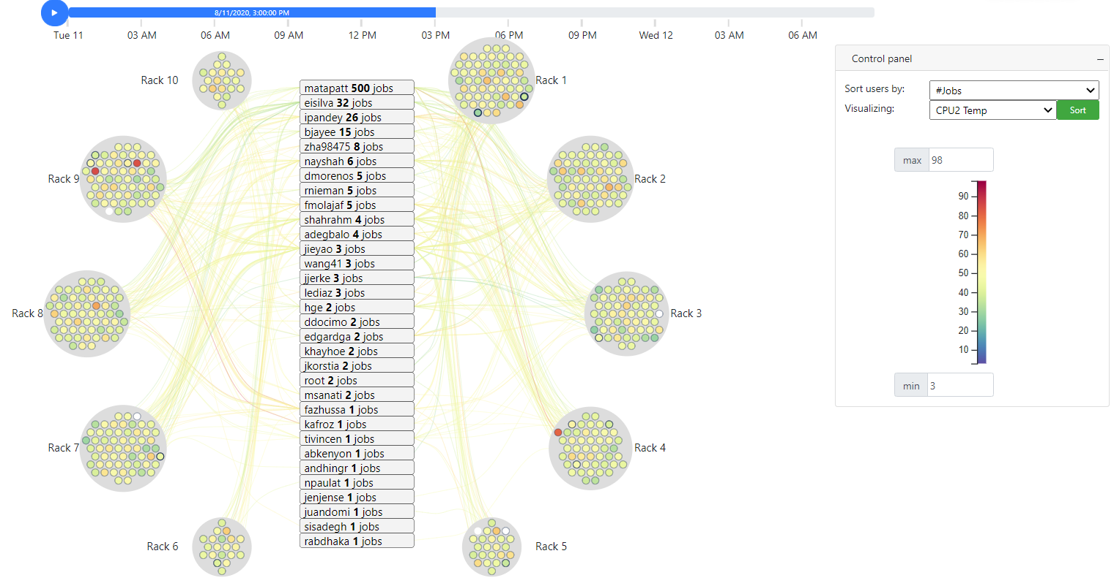
JobViewer
High CPU2 Temperature
August 11, 2020 3:00:00 PM
compute-9-47
compute-9-4
compute-4-33

Slide 8
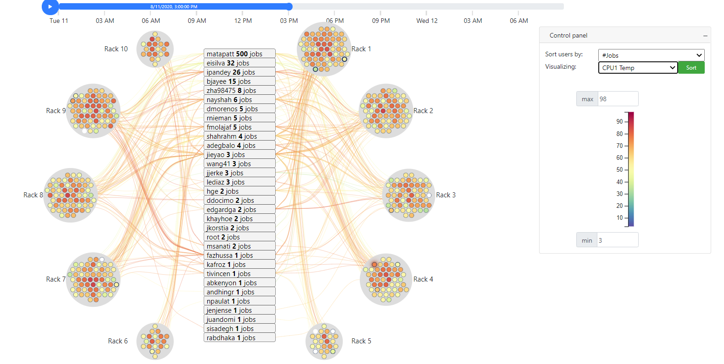
JobViewer
High CPU2 Temperature
August 11, 2020 3:00:00 PM
compute-9-47
compute-9-4
compute-4-33

Slide 9
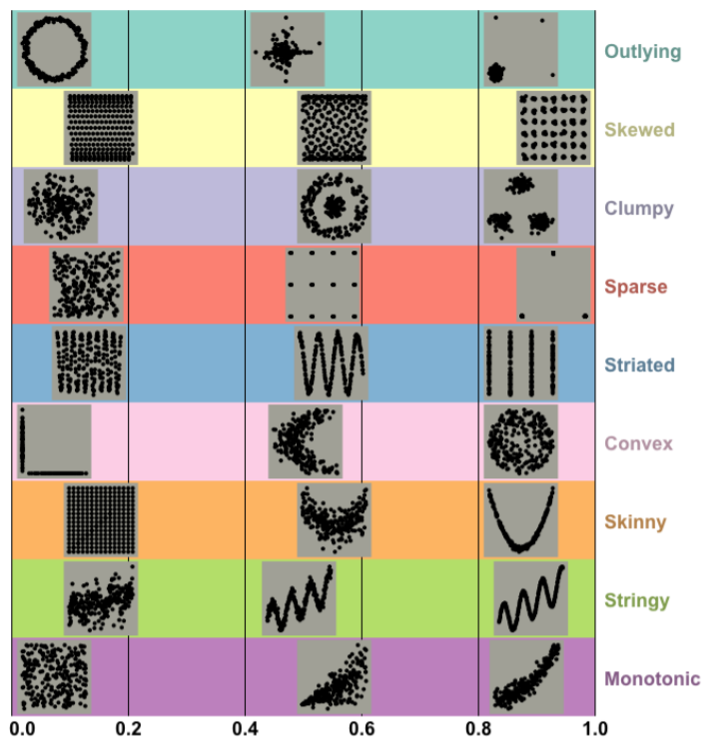
Scagnostics Viewer

Slide 10
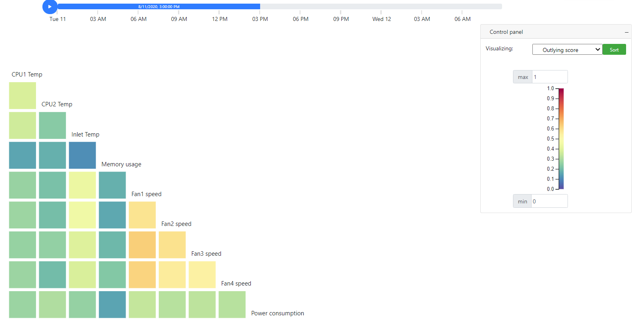
Scagnostics Viewer
Outlying score of CPU1 Temp v.s. CPU2 Temp
from 467 data points (467 nodes)

Slide 11
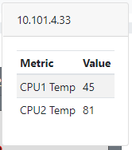
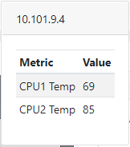
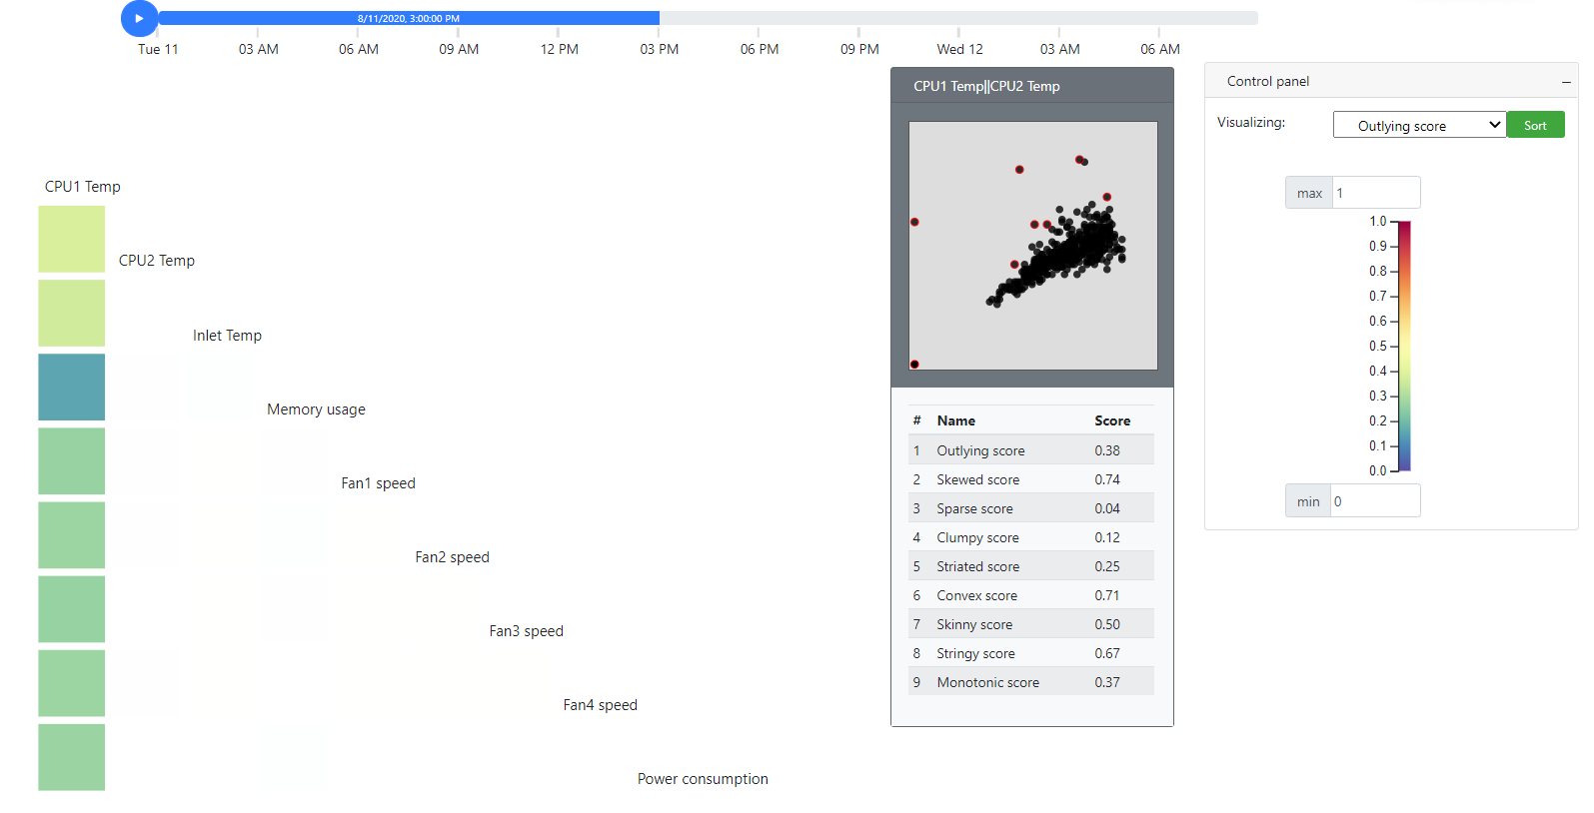
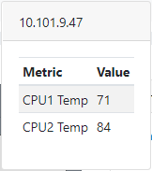
Scagnostics Viewer

Slide 12
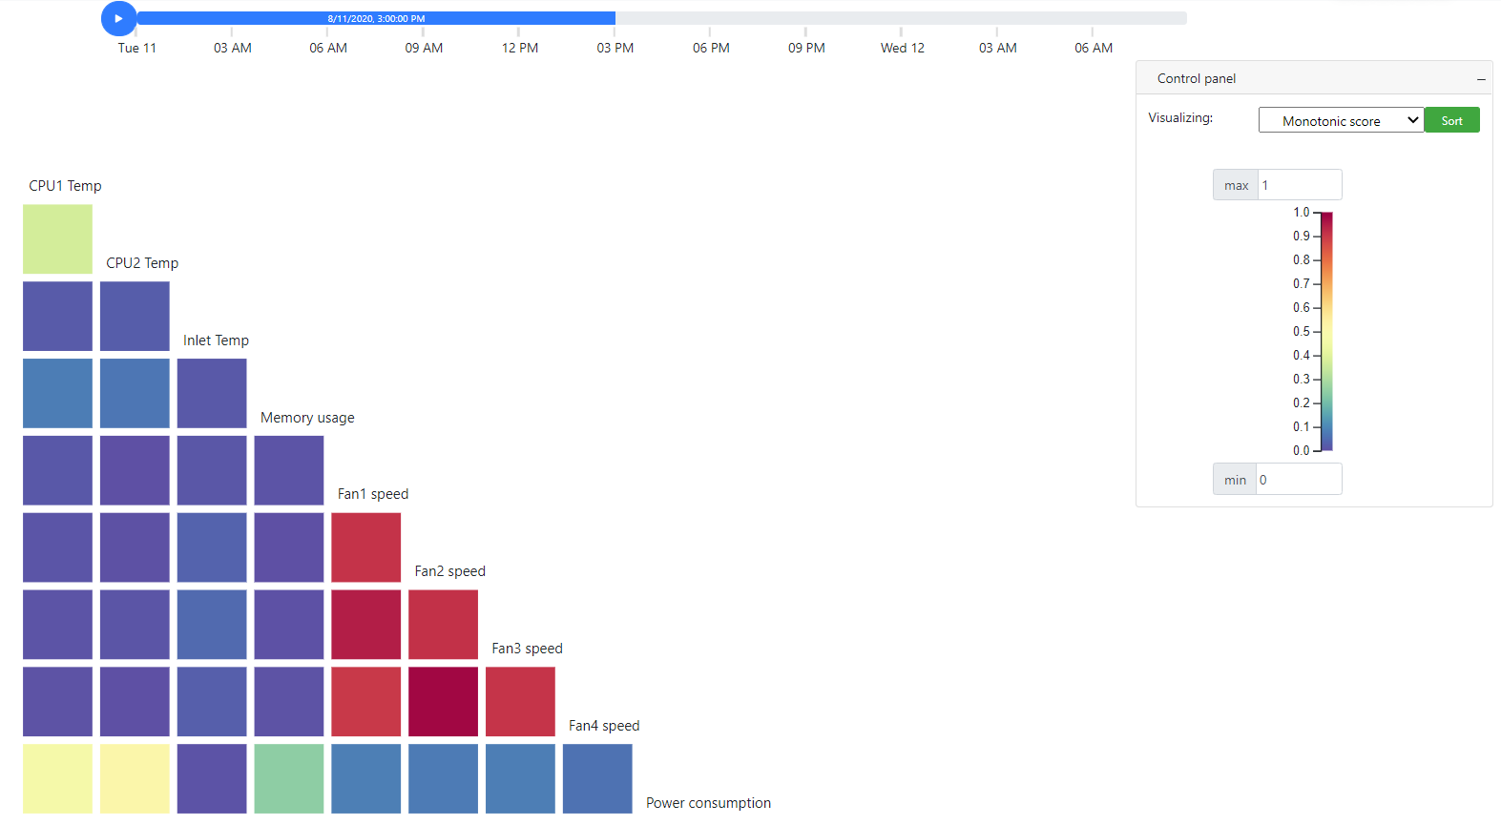
Scagnostics Viewer

Slide 13
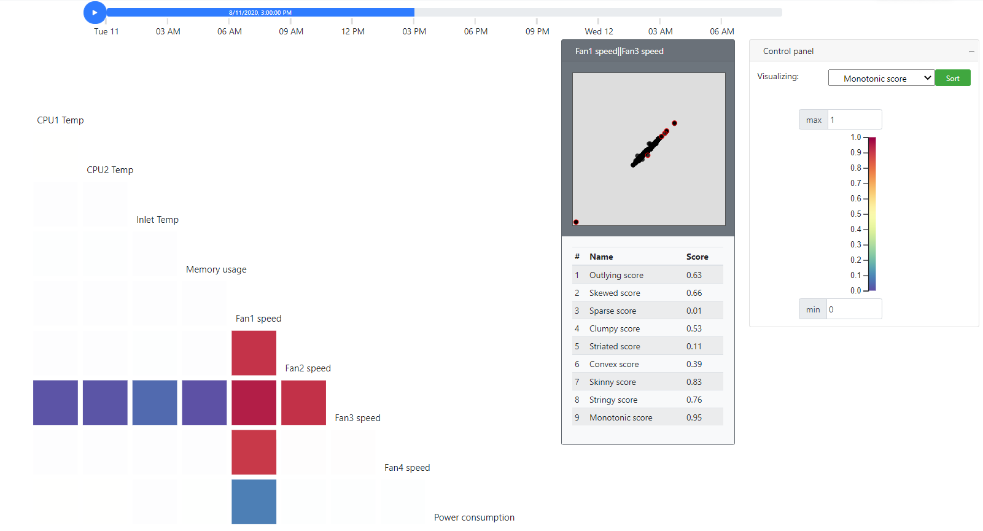
Scagnostics Viewer

Slide 14
Scagnostics Viewer
Historical data
https://idatavisualizationlab.github.io/HPCC/scagnosticsViewer/index.html
Realtime
https://idatavisualizationlab.github.io/HPCC/scagnosticsViewer/index.html?mode=realTime

